Slide 1
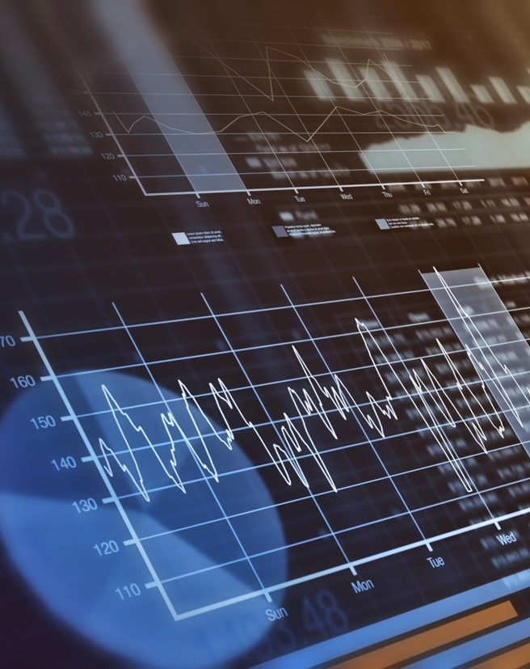

Twitter-Based Financial Sentiment Analysis
Presented By
Johnathan Fritsche
Mia Hanekamp
Sam Ryklansky

Slide 2

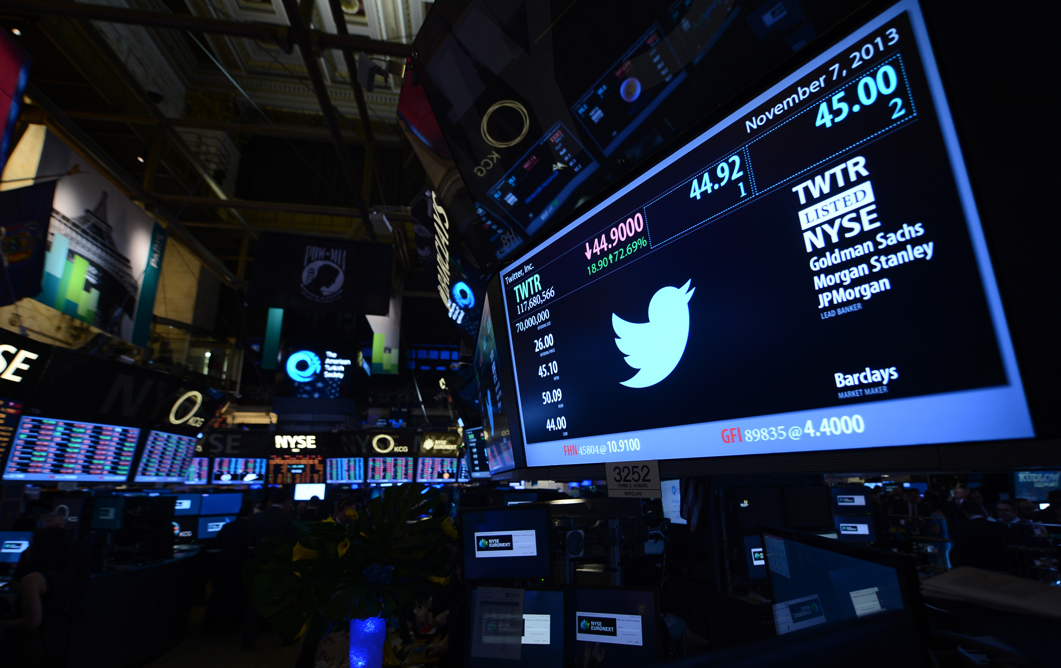
Introduction
The recent studies of sentiment analysis on social media platforms show that the overall sentiment using polarity score can be used to predict many different areas of interest.
The investor sentiment on the social media platform such as Twitter should correlate well with stock prices since investor behavior is dependent on their sentiment towards a company’s performance.

Slide 3
Literature Review
FinBERT: Financial Sentiment Analysis with Pre-trained Language Models (Araci D.)
Universal language model fine-tuning for text classification (Howard J. et al.)
DP-LSTM: Differential Privacy-inspired LSTM for Stock Prediction Using Financial News (Li et al.)
Detecting Semantic Orientations in Economic Texts (Malo P et.al.)
Sentiment Analysis of Twitter Data for Predicting Stock Market Movements (Pagolu V. et. al)

Slide 4
Datasets
Twitter Dataset
Stock Dataset
The dataset contains 943,672 tweets dated from April 9 to July 16, 2020.
1300 tweets were manually classified as positive, neutral, or negative sentiment.
The tweets with the tag for S&P 500 as well as the tags for the top 25 companies on the S&P 500 list were collected.
The dataset contains 105813 stock prices for more than 1,000,000 companies from Jan 1, 1996 to Aug7th, 2020 scraped from Yahoo Finance.
The dataset is then limited to the top 25 companies on S&P 500 list between April 9 to July 16, 2020.

Slide 5
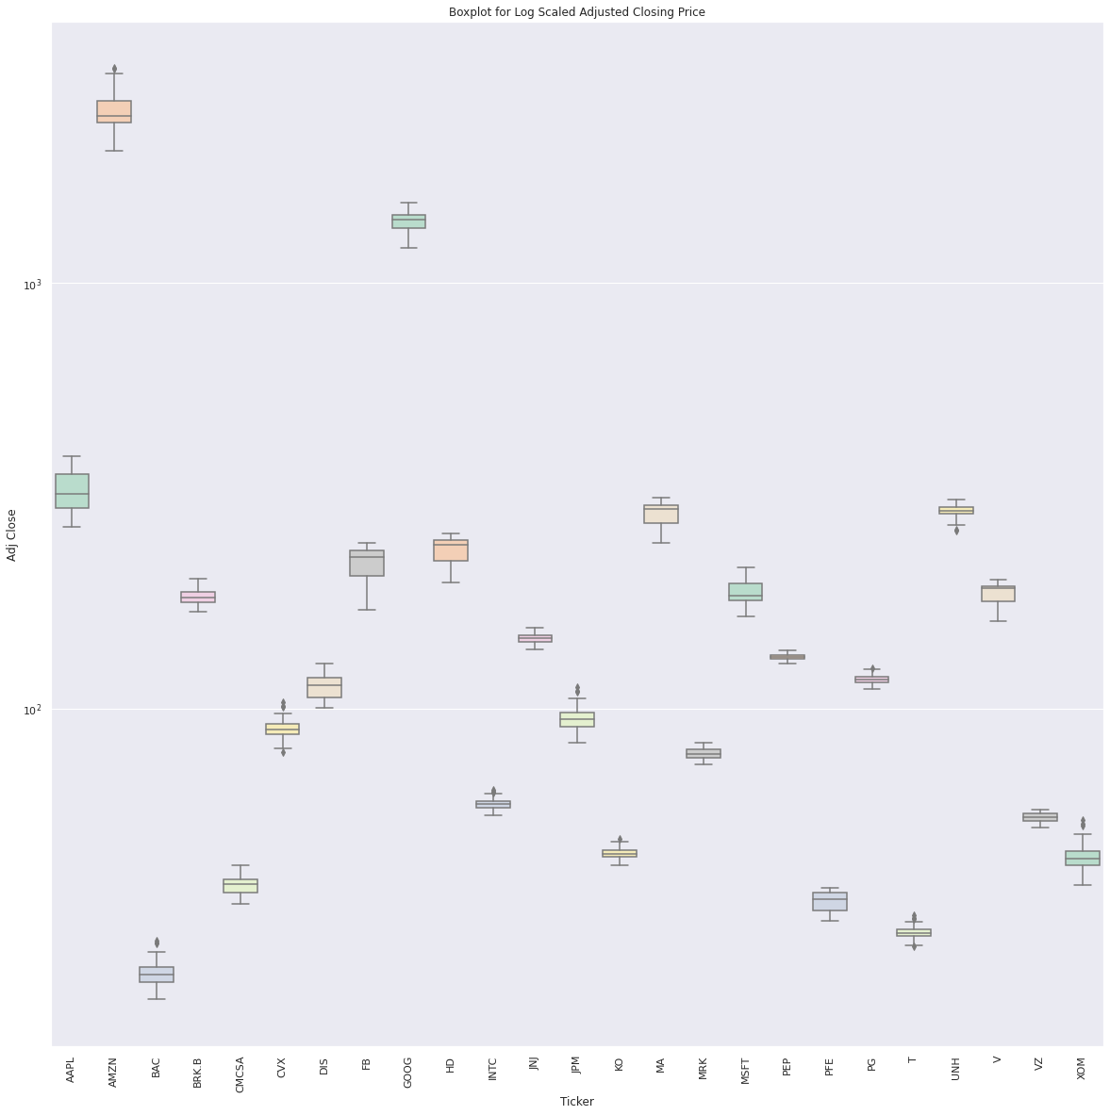
Preliminary Analysis: Stock Data

Slide 6
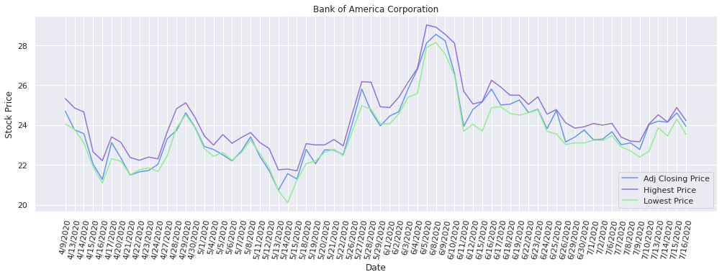
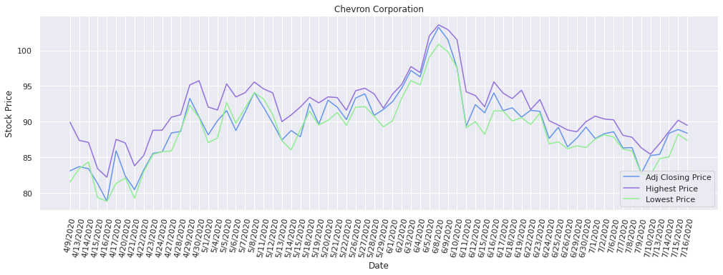
Preliminary Analysis: Stock Data

Slide 7
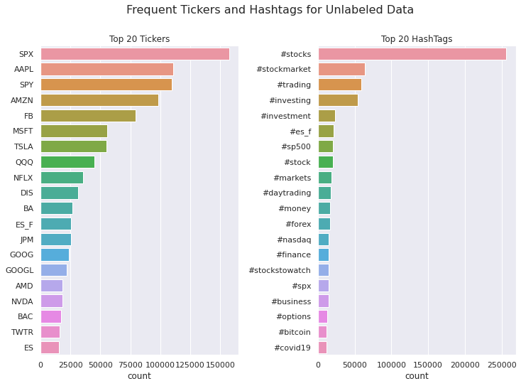
Preliminary Analysis: Twitter Data

Slide 8
Text Preprocessing
regex
Preprocessing
stopwords
Delete URLs
Delete Emojis, symbols and pictographs
Delete handles

Slide 9
Content 2
Subtitle
Subtitle
Subtitle
Add text, images, art, and videos.
Add transitions, animations, and motion.
Save to OneDrive, to get to your presentations from your computer, tablet, or phone.
Add text, images, art, and videos.
Add transitions, animations, and motion.
Save to OneDrive, to get to your presentations from your computer, tablet, or phone.
Add text, images, art, and videos.
Add transitions, animations, and motion.
Save to OneDrive, to get to your presentations from your computer, tablet, or phone.

Slide 10
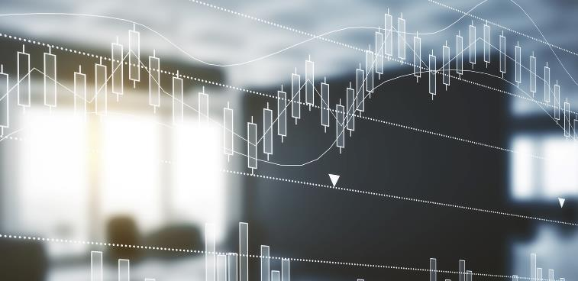

Discussion and Conclusion
Write discussion and conclusion here

